Slide 1
No Metrics Are Perfect:
Adversarial Reward Learning for Visual Storytelling
Xin Wang∗, Wenhu Chen∗, Yuan-Fang Wang , William Yang Wang
University of California, Santa Barbara
ACL 2018
王瑞泽
18210860032

Slide 2
Outlines
Background
Related Work
Motivation
Model
Experiments
Conclusion

Slide 3
Outline
Background for visual storytelling

Slide 4
Background
Visual storytelling is a challenging and important task in AI that connects CV and NLP.
Most of the current visual to language work focuses on the direct, literal description of images content (Image Caption), it is far from the capabilities needed by intelligent agents for naturalistic interactions.
Focusing on the task of visual storytelling has the potential to evolve AI towards more human-like understanding.
Visual storytelling could have tremendous impact in areas like virtual assistants, fully automated customer response systems, AI albums etc.

Slide 5
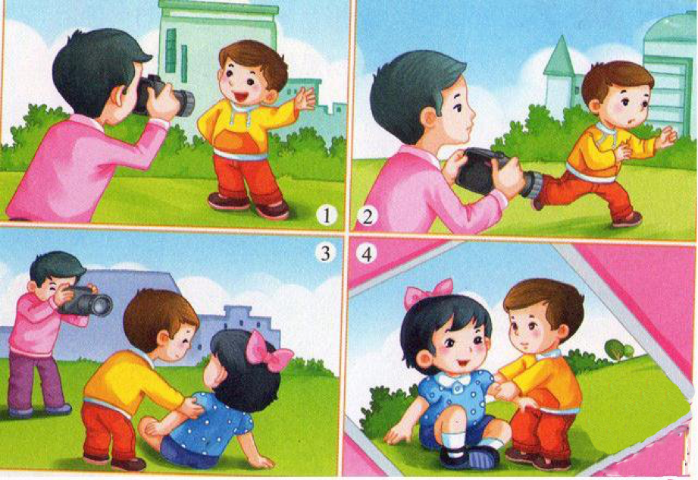
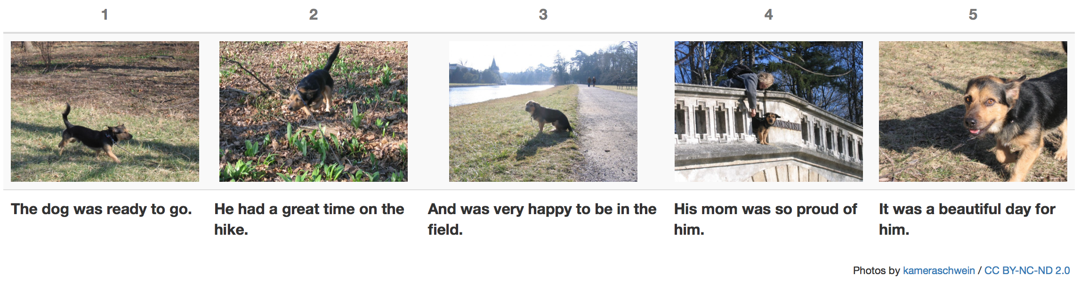
Task
Given an album (sequential images), generate a human like, narrative and descriptive story

Slide 6
Outlines
Background
Related Work
Motivation
Model
Experiments
Conclusion

Slide 7
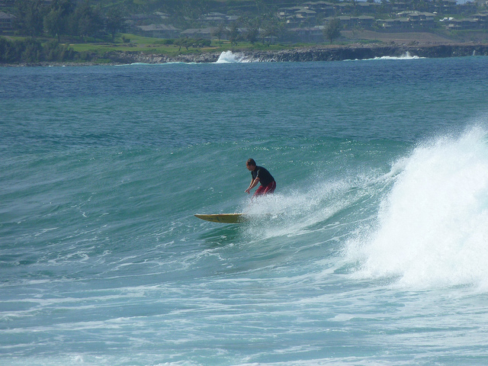
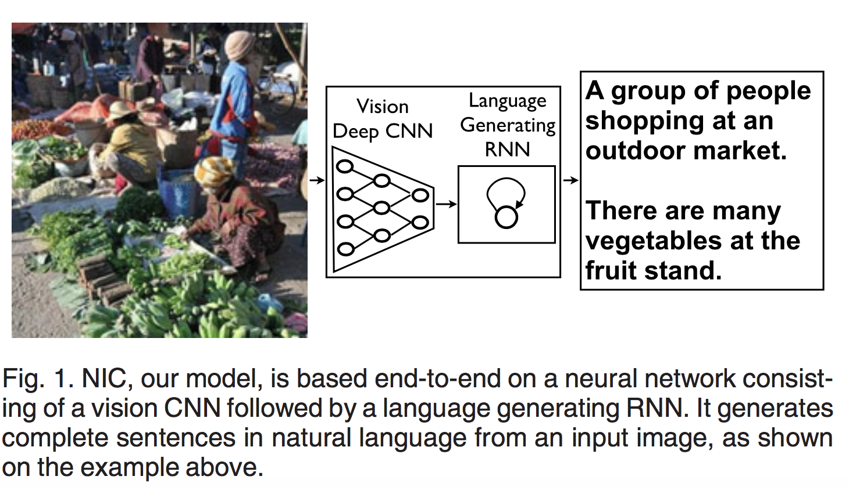
Related Work - Image caption
Show and tell: Lessons learned from the 2015 mscoco image captioning challenge(Vinyals, et al., 2017)
0) a man riding a wave on top of a surfboard . (p=0.040413)
1) a person riding a surf board on a wave (p=0.017452)
2) a man riding a wave on a surfboard in the ocean . (p=0.005743)
Google Brain在2015年宣布开源的一种自动图像描述系统“Show and Tell”

Slide 8
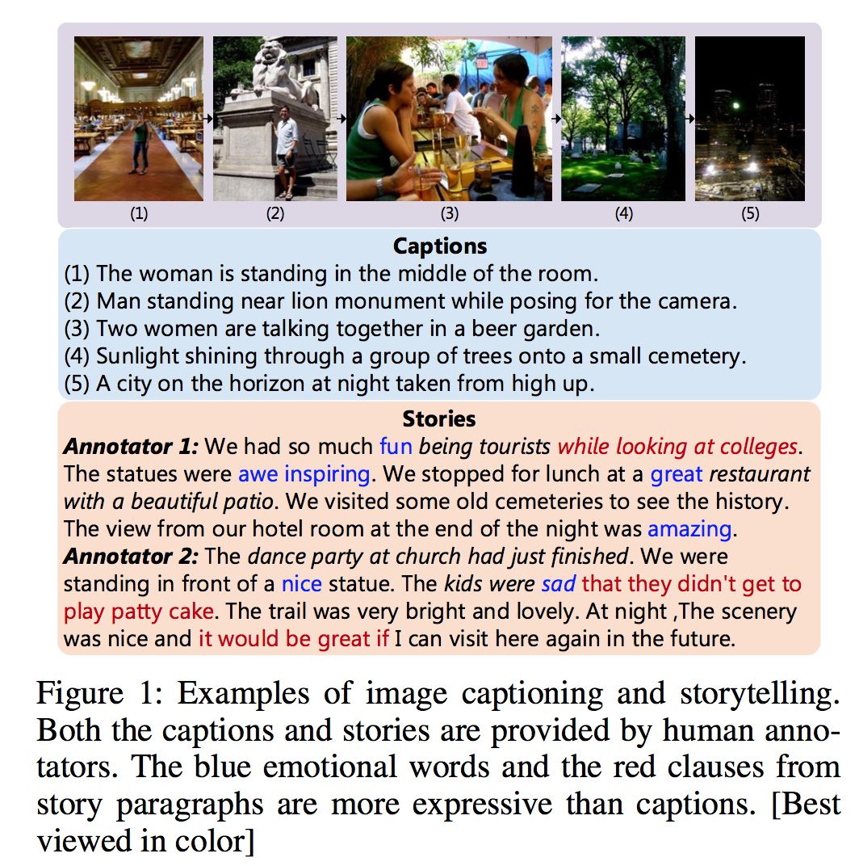
Image caption VS Visual Storytelling
Show, Reward and Tell: Automatic Generation of Narrative Paragraph from Photo Stream by Adversarial Training

Slide 9
Outlines
Background
Related Work
Motivation
Model
Experiments
Conclusion

Slide 10
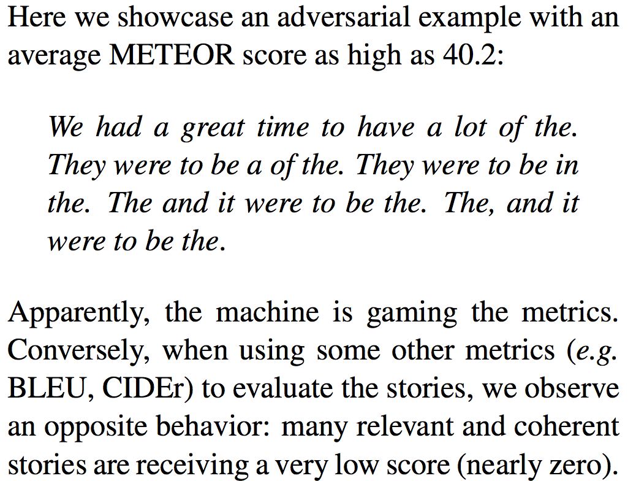
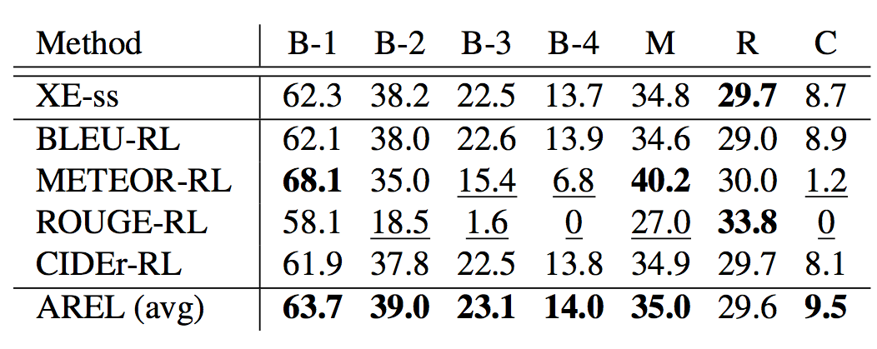
Motivation
Due to the limitations of automatic metrics on evaluating story quality, reinforcement learning methods with hand-crafted rewards are either too biased or too sparse.
In order to resolve the strong bias brought by hand-crafted rewards and produce more human-like stories, this paper propose an Adversarial Reward Learning (AREL) framework.

Slide 11
Outlines
Background
Related Work
Motivation
Model
Experiments
Conclusion

Slide 12
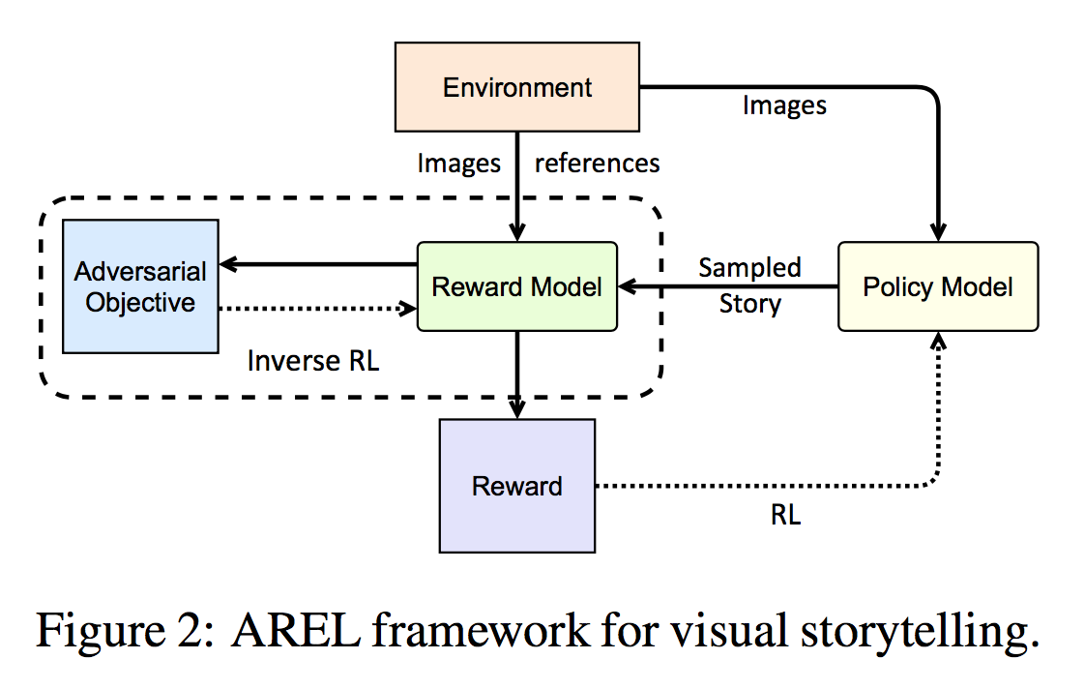
Model

Slide 13
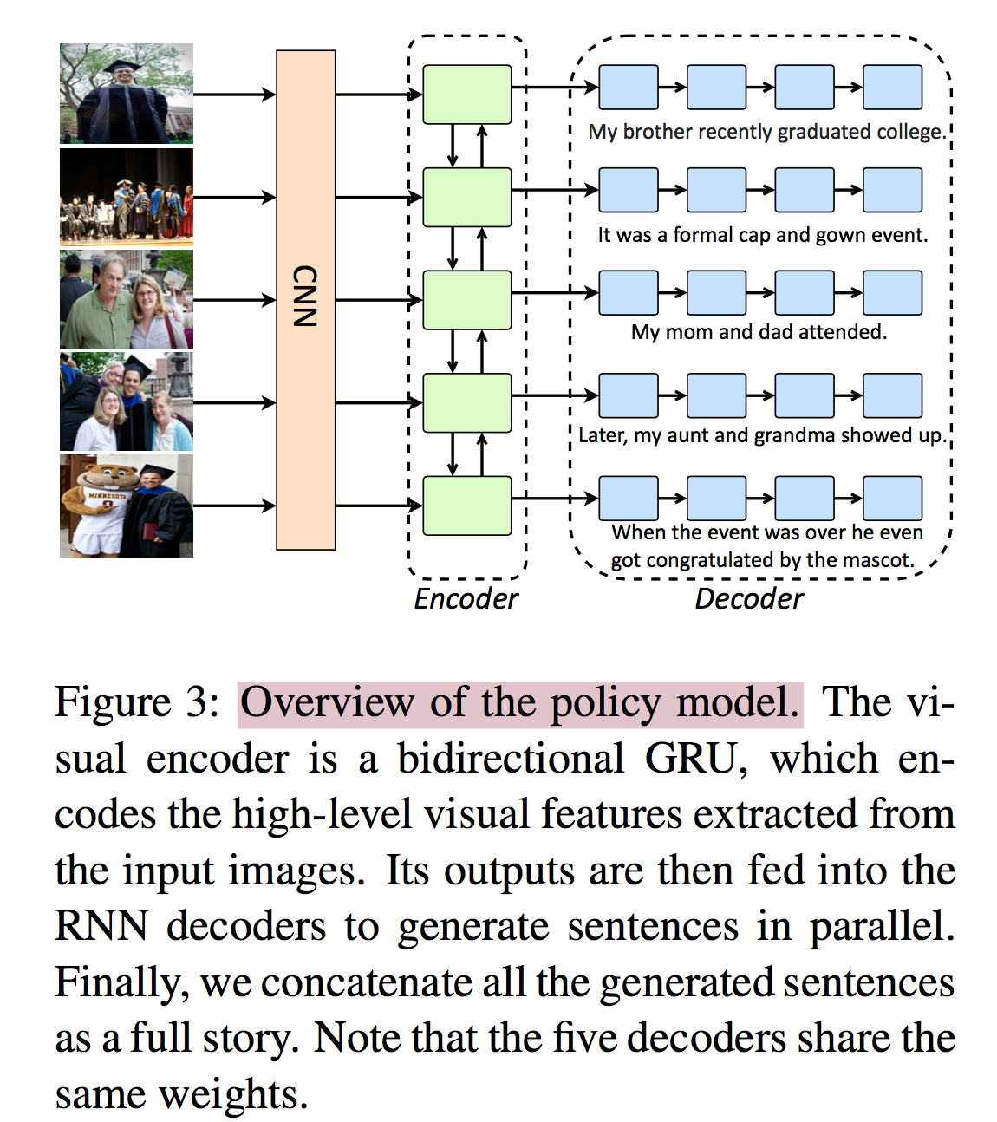
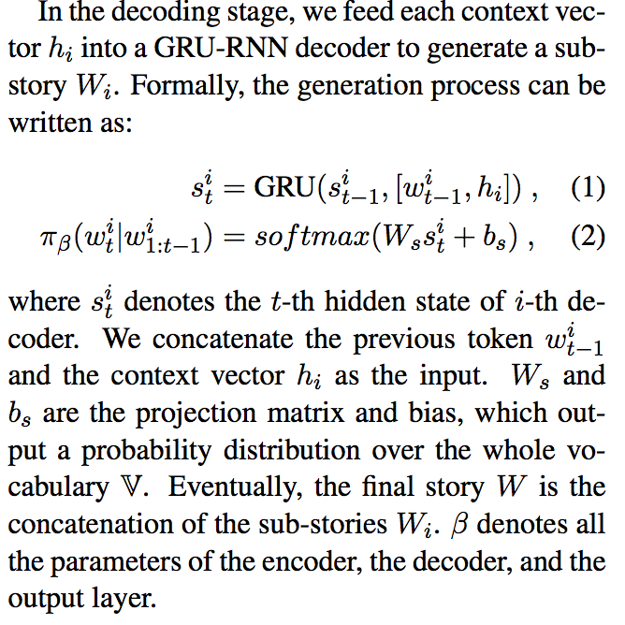
Model – policy model

Slide 14
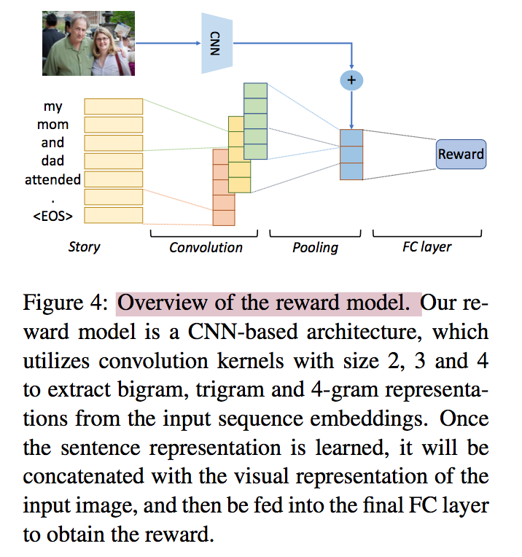
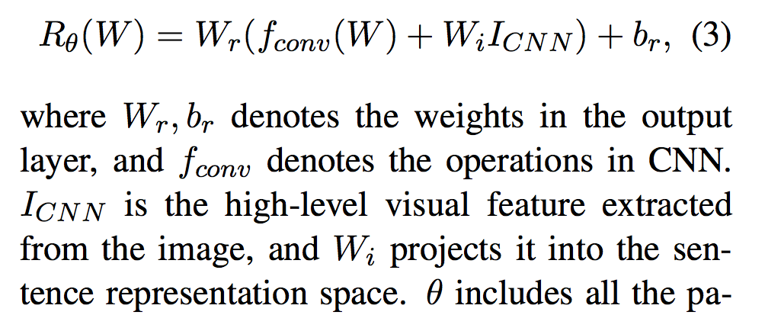
Model – reward model

Slide 15
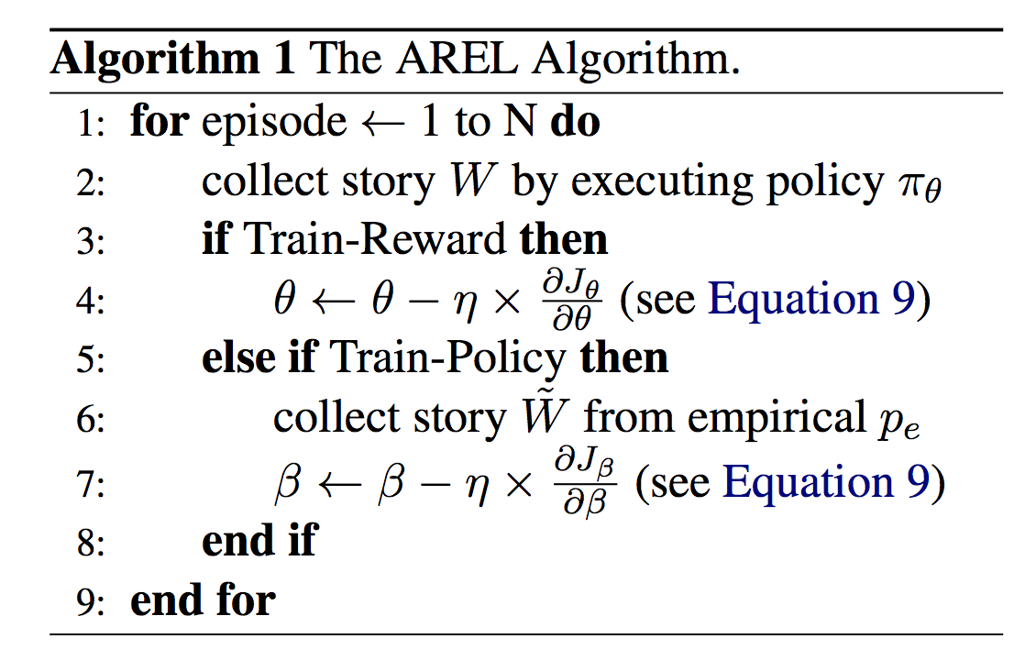
Model – training

Slide 16
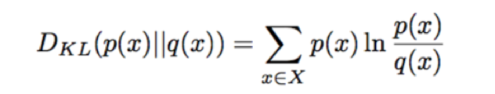
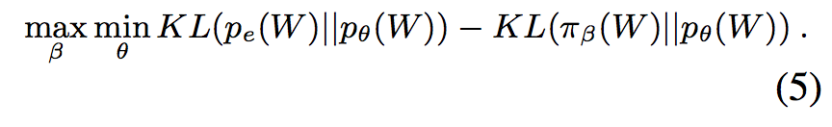
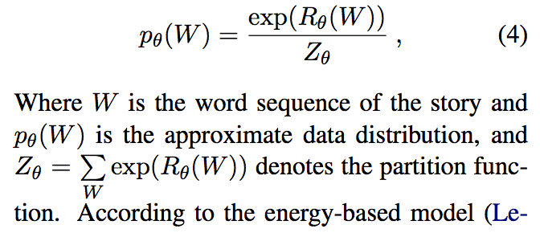
Model – training
Adversarial objective function :
p_{e} : Empirical distribution of the training-data
p_{θ}: Reward Boltzmann Distribution
π_{β}: Policy distribution
Reward Boltzmann Distribution

Slide 17
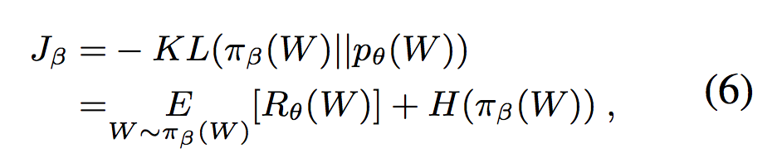
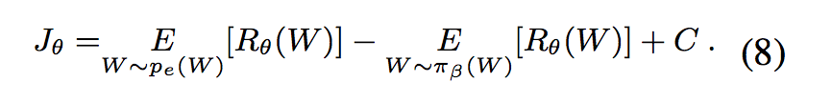
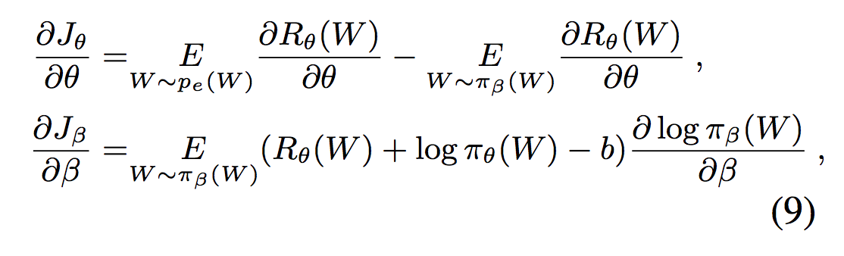
Model – training
adversarial objective function :

Slide 18
Outlines
Background
Related Work
Motivation
Model
Experiments
Conclusion

Slide 19
Experiment setup
Dataset with detail information
VIST Dataset (Huang et al., 2016) is the first dataset for visual storytelling.
The dataset is split as training, validation, and test following 80%:10%:10%.
After filtering the broken images, there are 40,098 training, 4,988 validation, and 5,050 testing samples. Each sample contains one story that describes 5 selected images from a photo album.
The total image files size is 320G, and the total text annotation files size is 310M.

Slide 20
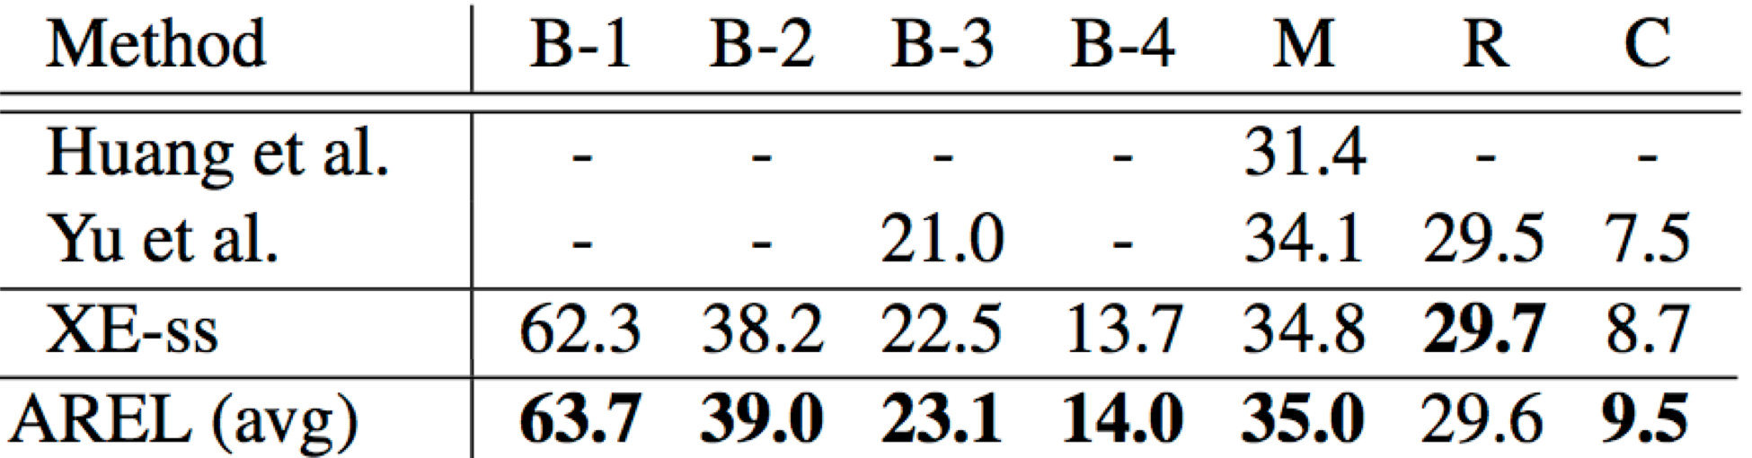
Experiment setup
Evaluation metrics
BLEU (B-1,B-2,B-3,B-4)
ROUGE
CIDEr
METEOR
Baselines
From:
Visual storytelling(Huang et al., 2016)
Hierarchically-Attentive RNN for Album Summarization and Storytelling(Yu et al., 2017)

Slide 21
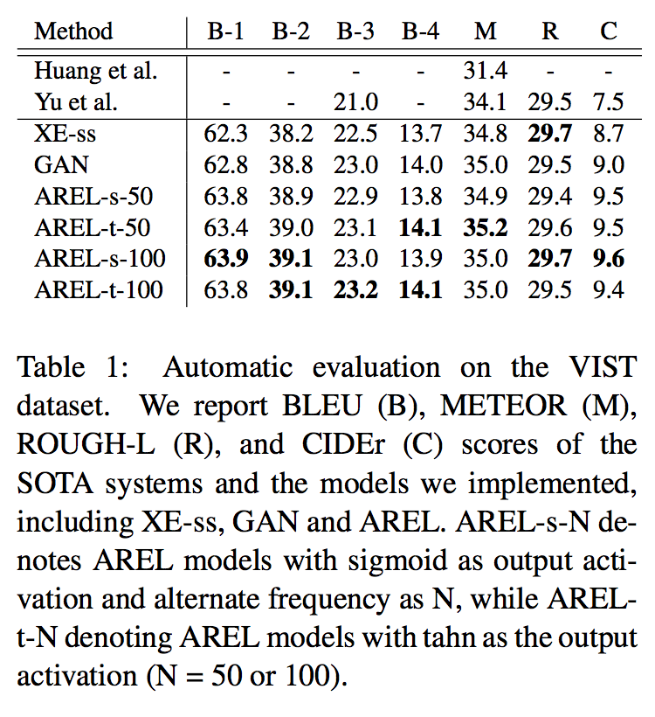
Experimental results
Quantitative results

Slide 22
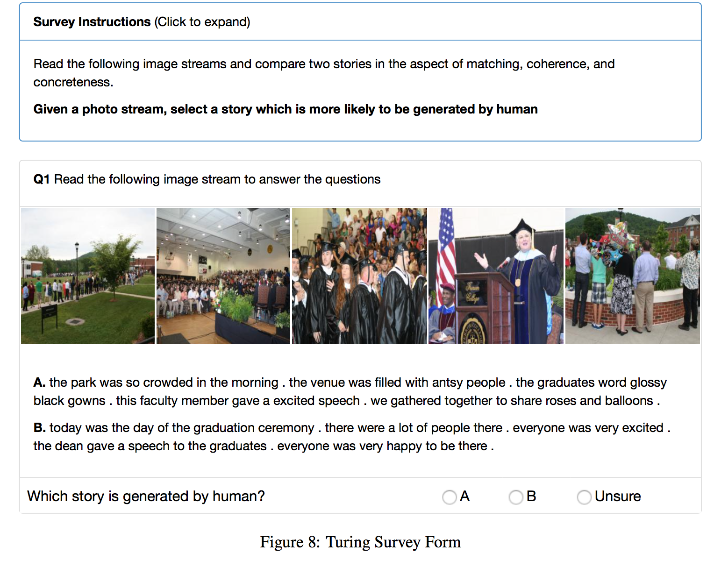
Experimental results
Quantitative results

Slide 23
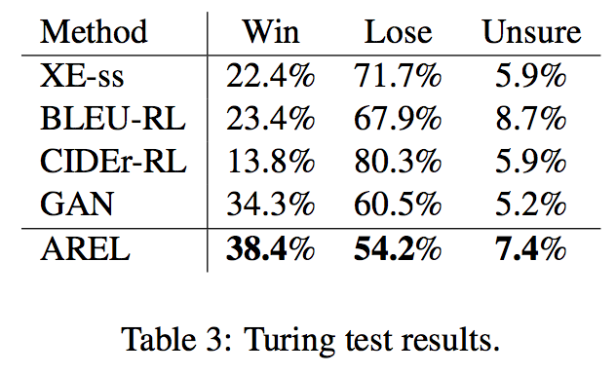
Experimental results
Quantitative results

Slide 24
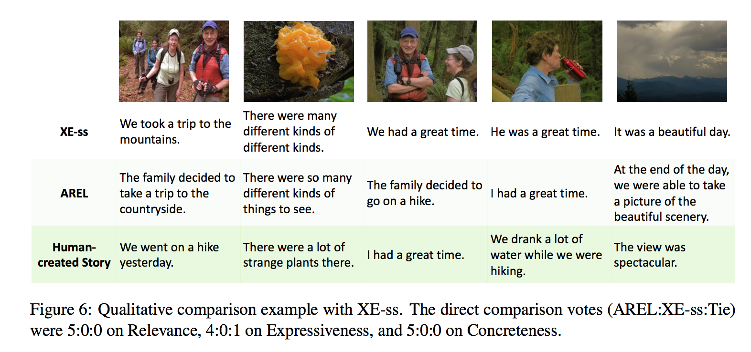
Experimental results
Qualitative results

Slide 25
Outlines
Background
Related Work
Motivation
Model
Experiments
Conclusion

Slide 26
Conclusion
Propose an adversarial reward learning framework and achieve the state-of-the-art results on automatic metrics.
Empirically analyze the limitations of the automatic metrics for story evaluation, no metrics are perfect.
Design and perform a comprehensive human evaluation via Amazon Mechanical Turk, which demonstrates the superiority of the generated stories of our method on relevance, expressiveness, and concreteness.

